Slide 1


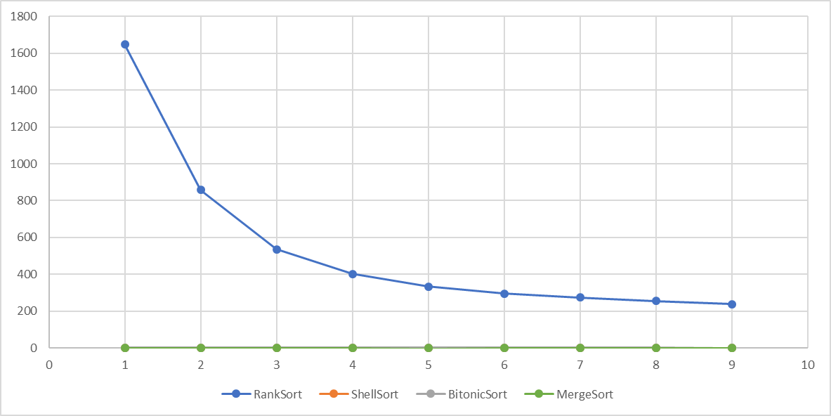
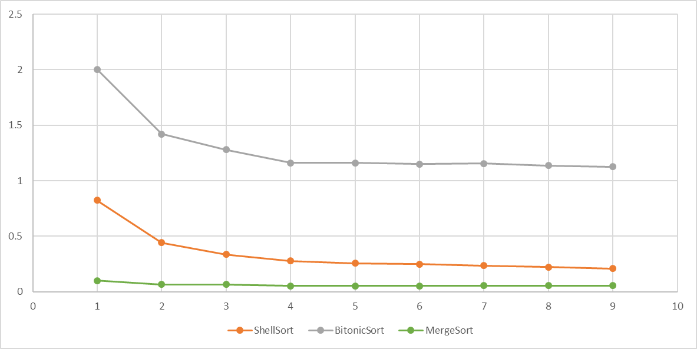
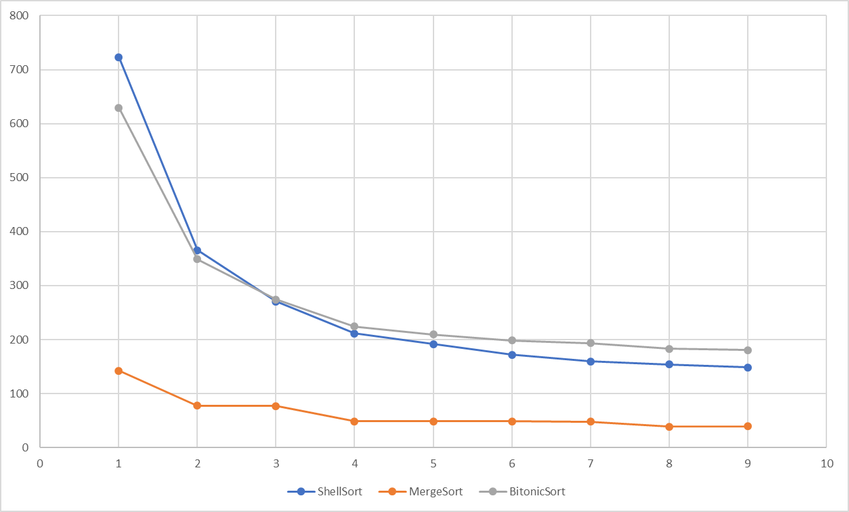
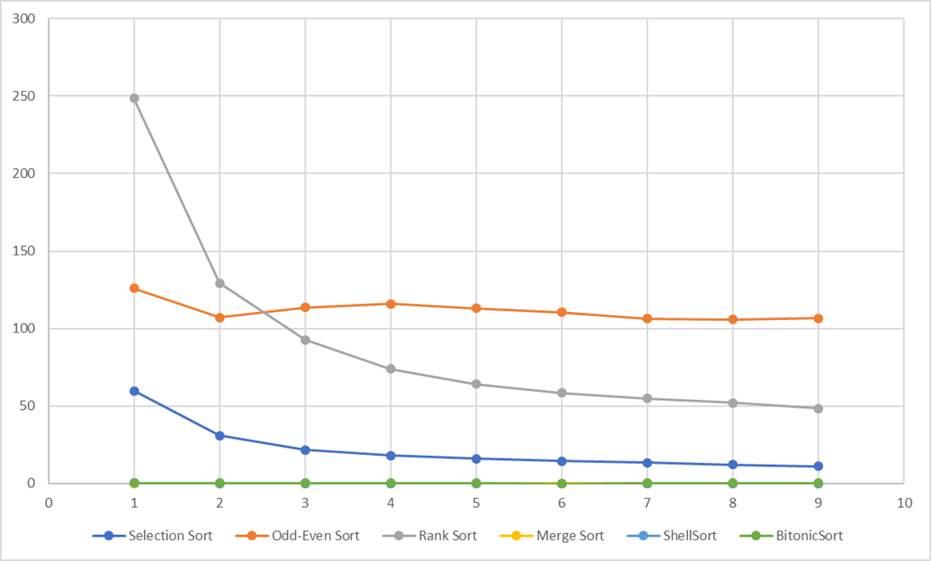
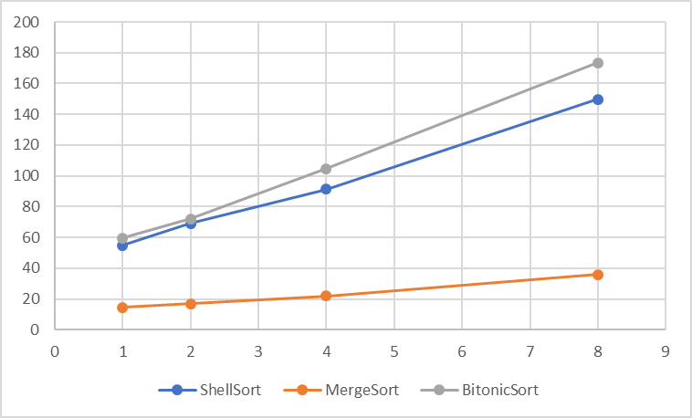
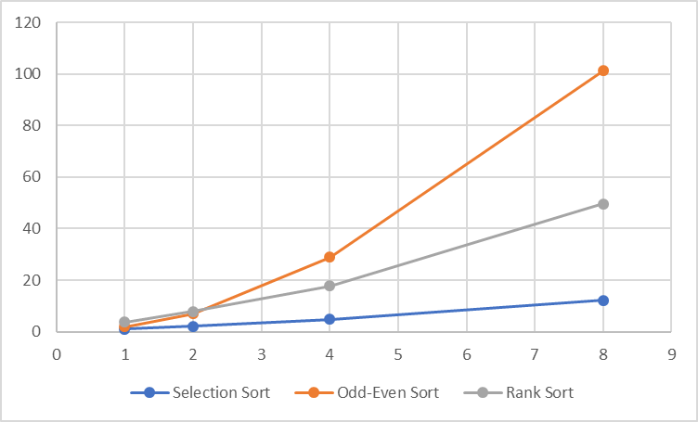



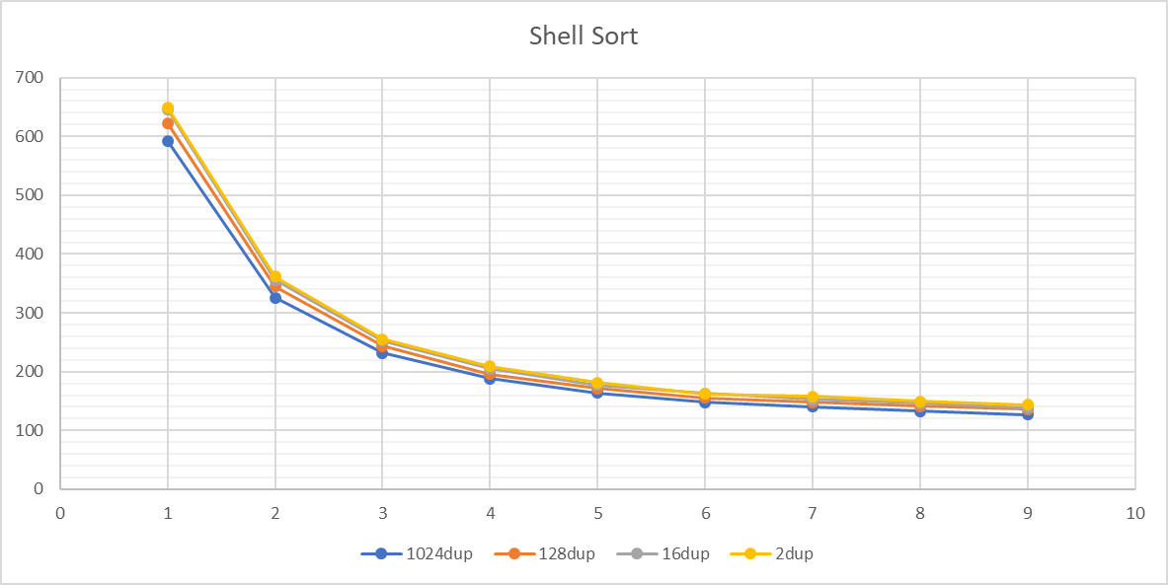
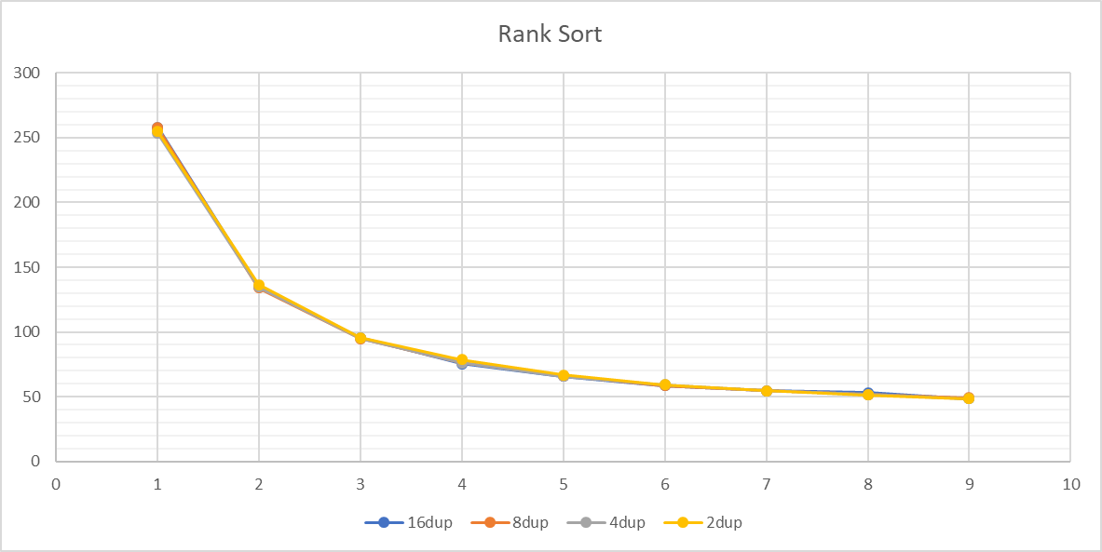
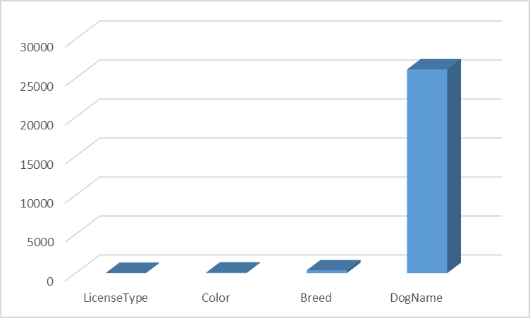
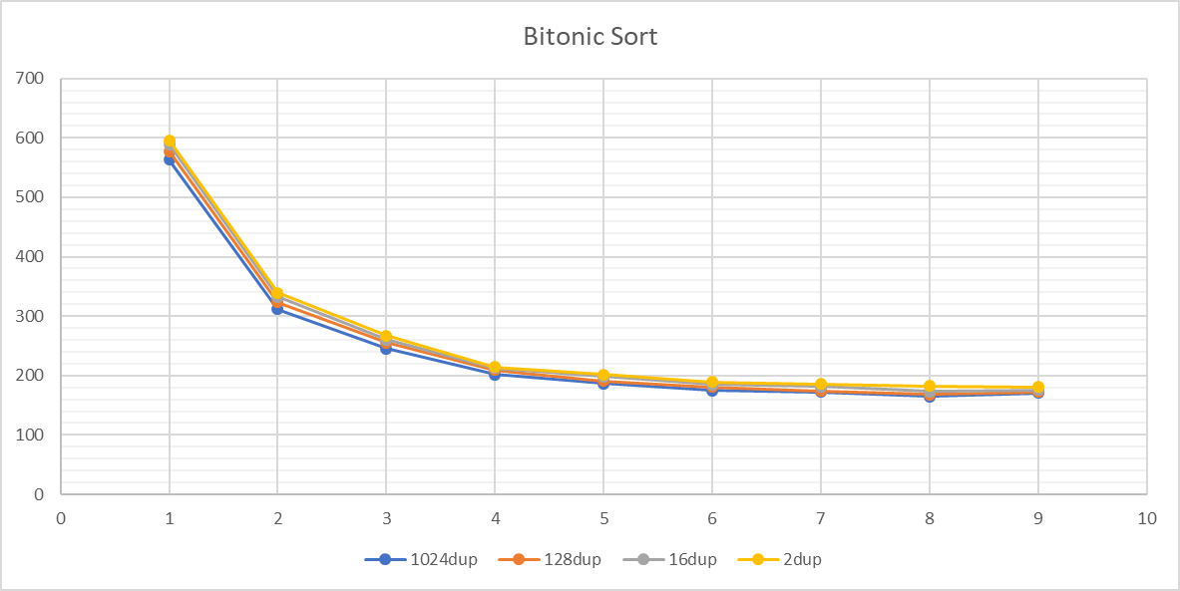
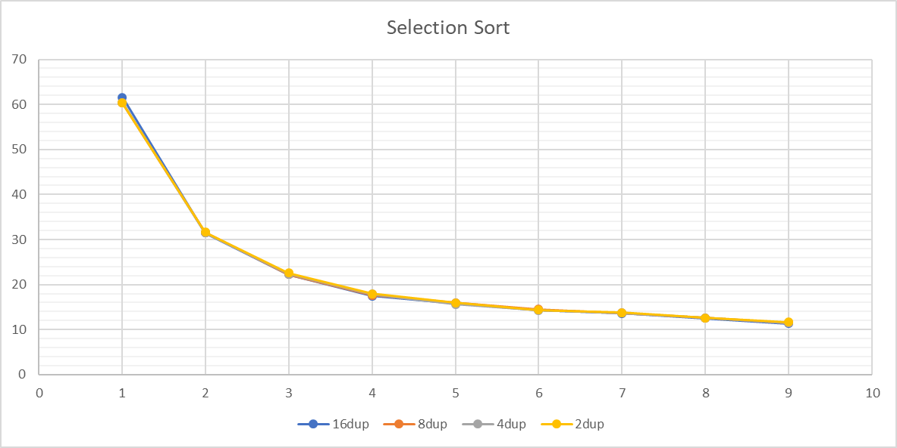
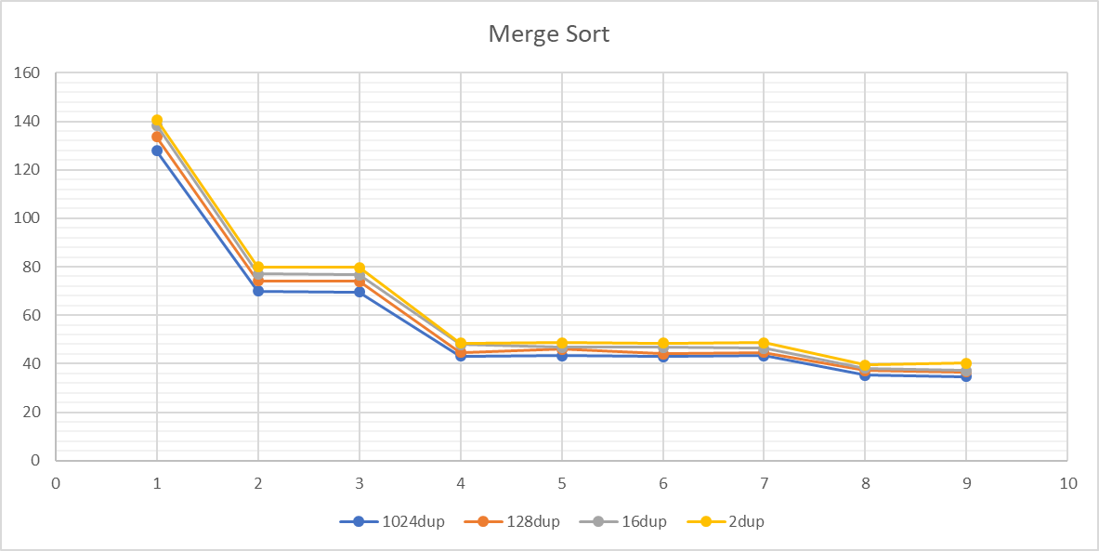
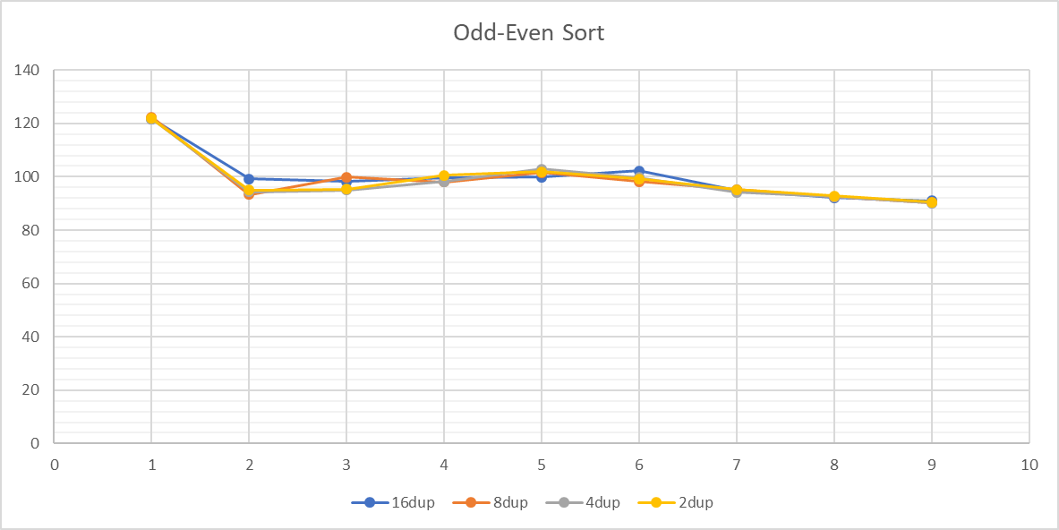
Analysis and Comparison of Parallel Sorting Algorithms
Chen-Kai Tsai, Jing-Chiou Liou
Computer Science, Kean University, tsaiche@kean.edu
Sorting Database with Shell Sort, Bitonic Sort, Rank Sort and Merge Sort
Introduction
Results
In this study, we focusing on applying sorting algorithms on parallel programming and analyze their behavior. We select six sorting algorithms including Shell Sort, Bitonic Sort, Merge Sort, Rank Sort, Selection Sort and Odd-Even Sort and apply different tests and analyze the result. The first two set of tests are strong scaling performance tests and weak scaling performance tests with pure integer datasets. The third set of tests are testing the behavior of the algorithm under uniform distribution datasets with different degree of duplication. The final set of tests are applying and modifying these parallel sorting to sort real-world data in databases. With all the information provided, we aim to help programmer understand what need to be take into consideration when choosing sorting algorithms and serve as a basis for their further analysis.
Strong Scaling Performance Tests
Weak Scaling Tests
Uniform Dataset Tests
Dataset Size: 2GB
Dataset Size: 1MB
For all the diagrams in the result section, the x axis is the number of threads that the parallel program uses and the y axis is the execute time in seconds.
Conclusions
Merge Sort has the Best Performance
It has best sequential complexity. However, it need extra space for merge.
Parallel Version of Sorting Algorithm’s Performance Depends on Its Sequential Performance
The performance of parallel version sorting algorithms are heavily affected
by their sequential performance.
Weak Scaling Performance Tests can be Tuned
We can tune the ratio between the dataset size and the computational
resource to help decide assigned hardware resource for certain data size.
The Influence of Duplicated Elements in Dataset
In our tests, there is no certain performance of a sorting algorithm surpass
others because of this factor.
The Number of Comparison Operations has Most Influence When Sorting Text in Database
String comparison operations are more expensive than the swapping
operation. Therefore, algorithm with less comparison will have better
performance.
Dataset Size: 256MB ~ 2GB
Dataset Size: 128KB ~ 1MB
Methods and Materials
Test Environment:
1) Operating system: Ubuntu 18.04.4 LTS with POSIX thread model
2) CPU: Intel Core i7-9750H
3) Memory size: 32GB
4) GCC version: 7.4.0 with OpenMP version 4.5
5) MariaDB version 10.1.44
Test Dataset:
Strong Scaling and Weak Scaling performance Tests: The dataset is generated by rand() specified in C stdlib.h function will use linear feedback shift register algorithm mentioned in the ISO C standard.
Uniform Dataset Tests: The dataset is generated by generator defined in C++ STL with predefined random number generator “default_random_engine” and random number distributions “uniform_int_distribution”.
Sorting Database with Shell Sort, Bitonic Sort, Rank Sort and Merge Sort: The testing data is public dataset published by Allegheny County / City of Pittsburgh / Western PA Regional Data Center and maintained by Samuel Mazza (Samuel.Mazza@alleghenycounty.us). The diagram above shows the distribution of the data inside the dataset.
Dataset Size: 2GB
Dataset Size: 1MB
References
Darko Božidar and Tomaž Dobravec. Comparison of parallel sorting algorithms. Technical report November 2015
Clay Breshears. The Art of Concurrency May 2009: First Edition. ISBN: 978-0-596-52153-0
Henrik Swahn Faculty of Computing Blekinge Institute of Technology SE-371 79 Karlskrona Sweden. Pthreads and OpenMP A performance and productivity study
OpenMP Website: https://www.openmp.org/
Knuth, Donald E. (1997). "Shell's method". The Art of Computer Programming. Volume 3: Sorting and Searching (2nd ed.). Reading, Massachusetts: Addison-Wesley. pp. 83–95. ISBN 978-0-201-89685-5.
Shell, D. L. (1959). "A High-Speed Sorting Procedure" (PDF). Communications of the ACM. 2 (7): 30–32. doi:10.1145/368370.368387
K. E. BATCHER Goodyear Aerospace Corporation Akron, Ohio. Sorting networks and their applications
Jayshree Ghorpade, Jitendra Parande, Madhura Kulkarni, Amit Bawaskar GPGPU PROCESSING IN CUDA ARCHITECTURE Advanced Computing: An International Journal ( ACIJ ), Vol.3, No.1, January 2012
Ayushi Sinha, Supervisor: Prof. Kunal Agrawal Sorting on CUDA August 20, 2010
Dmitri I. Arkhipov, Di Wu, Keqin Li, and Amelia C. Regan Sorting with GPUs: A Survey September 8 ,2017
OpenMP Architecture Review Board OpenMP Application Programming Interface
Dominik Żurek, Marcin Pietroń, Maciej Wielgosz, Kazimierz Wiatr THE COMPARISONOF PARALLEL SORTING ALGORITHMSIMPLEMENTED ONDIFFERENT HARDWARE PLATFORMS 2013

